Slide 1
Real-Time Signal Transition Software for
Advanced Traffic Controller
Advanced Technologies Incorporated (ATI)

Slide 2
Overview
Signal Control Program Environment (SCOPE)
Advanced Traffic Controller (ATC)
8 phase NEMA logic
Developed under an SBIR initiative of U.S. Department of Transportation
Safety-critical, software logic redundant, open source traffic signal control software
Developed under the initiative of U.S. Department of Transportation

Slide 3
Disadvantages of Current Approach
proprietary
sole-source acquisitions
long-term contracts
inflated costs
promotes non-competition
kills innovation
"when electrical contractors pay inflated prices …they are passed on to the taxpayers. Primarily what we're looking at is to make sure that these guys stop so that taxpayers don't get stuck with the tab“ - California State Attorney's Office

Slide 4
Benefits of Open-Source
Increased software efficiency as evaluation of logic, algorithms, and design by industry professionals, researchers, and programmers will be made possible.
Increased software stability and safety as countless developers will have the ability to search code for bugs and exceptions.
Spurred interest in traffic signal control as software will no longer be proprietary or require large licensing fees.
Ability of corporations and municipalities to alter traffic control logic to best meet a given city’s needs.
Ability of government traffic engineers to perform signal re-timing.
Increased competition in signal timing maintenance for localities wishing to use a third party.

Slide 5
Industry Interest
Greetings,
I work for a Canadian traffic monitoring company named Miovision and we are in the process of developing an new adaptive traffic control solution for a customer. The goal is to optimize traffic flow through their downtown core using embedded video analytics modules at each intersection (basically a very smart intersection sensors). At this stage of the design process, we have a good handle on the embedded system and video analytics; however, we still need a mechanism to invoke changes at the intersection level. Ideally, we would like to have our embedded video system communicate optimized phase changes directly to the traffic controller. Unfortunately, there is no clear means of communicating such information to proprietary traffic control applications. Therefore, we would like to evaluate the feasability of interfacing with SCOPE using your Java interface or possibly modifying SCOPE to accept external video sensor inputs...
Thank you.
Miovision Technologies Incorporated

Slide 6
Safety-Critical Software
Examples
  Medical Devices
  Aircraft Flight Control
  Weapons
  Nuclear Reactors
Failure would most likely directly lead to the loss of human life.

Slide 7
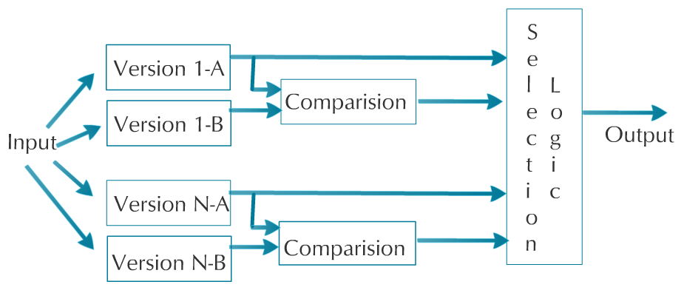
Safety-Critical Software Methods
N-Version Programming
Recovery Block
Consensus Recovery Block

Slide 8
N-version Programming Steps
1. The function to be implemented by an N-version software unit;
2. Data formats for the special mechanisms: comparison vectors (“c-vectors"), comparison status indicators (“cs-indicators"), and synchronization mechanisms;
3. The cross-check points (“cc-points") for c-vector generation;
4. The comparison (matching or voting) algorithm; and
5. The response to the possible outcomes of matching or voting

Slide 9
Recovery/Consensus Block
Combines N-Version Programming and Recovery Blocks
N-Version Program & Consensus Blocks not useful if multiple outputs are valid
Recovery Blocks makes use of an algorithm for acceptance test

Slide 10
Comparison of Existing Software
MITSIM
MIT’s Intelligent Transportation Systems (MITSIM)
Open source software.
Simulates an eight-phase dual-ring traffic signal controller, among many other configurations.
.118 page users manual.
The average McCabe complexity figure for the TMS C++ classes is 23.92.
That might be overlooked if the code was adequately commented, but, the comment to code ratio is only 10 percent.
ATI STAGE I
Use software developed by ATI during initial Stage I with the following caveats:
  1)Use sponsors in-depth knowledge of the TSCP software to ensure our software contains the same base functionality.
  2) Use the interfaces developed by Dr. Marco Zennaro as guide when porting finished software to an ATC.
  3)Use the MIT developed MITSIM documentation as a guide when developing SCOPE installation.
  Instructions and user's manual.

Slide 11
Comparision of Existing Software
PATH
California Partners for Advanced Transit and Highways (PATH)
Dr. Marco Zennaro developed the Berkeley Adaptive Traffic Control System Protocol (Berkeley ATCP2070) at the University of California Berkeley.
Developed specifically for the Econolite Model 2070 Advanced Traffic Controller.
Released under GPLv2 in May of 2008 and its current (and only) version is 1.0.
All initialization logic is hard-coded.
Magic numbers are used.
Threading not used.
Selected Approach
Dual redundant base traffic intersection controller prototype as part of the Stage I approach.
This prototype could control an intersection and contained the railroad preemption concept of NCHRP 3-66.
The prototype used a configuration file to “define” the intersection. The number of intersection approaches, traffic signals, lanes, and crosswalks are all modifiable without software constraints.
Safety Critical (Dual Redundant, Software Watchdog Timers, Protected Types, Exception Handling)

Slide 12
Modes of Operation
PRE-TIMED
A pre-timed controller has a predetermined and fixed cycle length, phase plan, and phase times.
Coordinating with adjacent pre-timed signals easy, since the start and end of green are predictable.
Pre-timed control is ideally suited to closely spaced intersections where traffic volumes and patterns are consistent on a daily or day-of-week basis.
Best suited to intersections where three or fewer phases are needed
ACTUATED
For an actuated controller cycle length, phase plan and phase times are controlled by detector actuations.
Phasing represents the fundamental method by which a traffic signal accommodates the various users at an intersection in a safe and efficient manner.

Slide 13
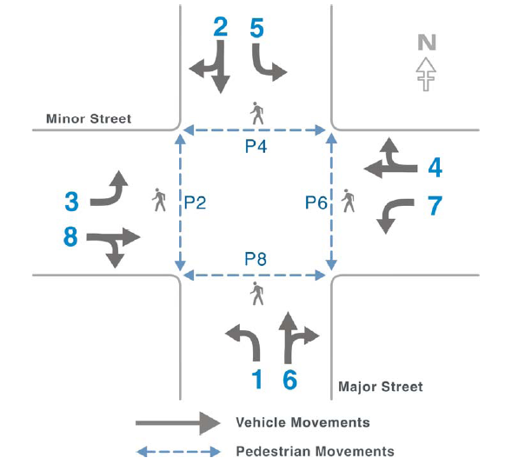
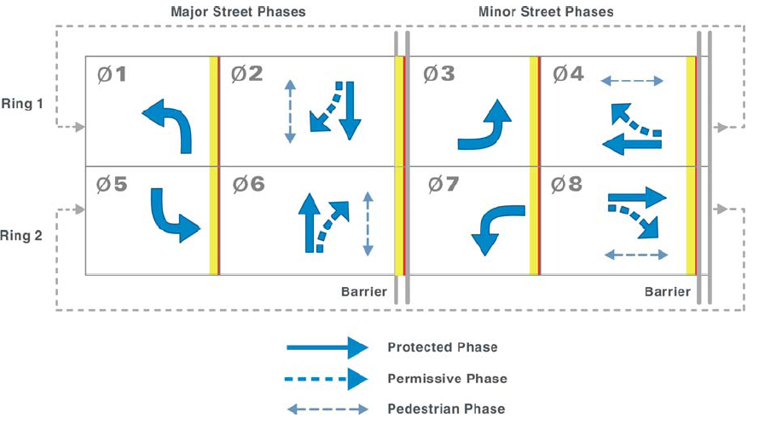
Modes of Operation
Phase Pair Diagram (left) Ring And Barrier Diagram (right)

Slide 14
Modes of Operation
Actuated and Advanced Concepts
Presence (Semi-Actuated) – the major road Phases remain green permanently until a actuated call on a minor Phase is detected. The minor phase runs once and then returns control to the major road phases.
Gap Out - A type of actuated operation for a given phase where the phase terminates due to a lack of vehicle calls within a specific period of time.
Gap Reduction - A type of actuated operation for a given phase where the phase terminates due to a lack of vehicle calls within a specific period of time, which is reduced after a specified period.
Recall - A call is placed for a specified phase each time the controller is servicing a conflicting phase. This will ensure that the specified phase will be serviced again. Types of recall include soft, minimum, maximum, and pedestrian.
Minimum Recall - A parameter which results in a phase being called and timed for its minimum green time whether or not a vehicle is present.
Maximum Recall - A parameter which results in a phase being called and timed for its maximum green time whether or not a vehicle is present.

Slide 15
Software Description
C++/Ada95
Runs on Linux
PowerPC Architecture
Runs on Peek ATC & Phytec PowerPC
Settings Configurable on
  Java GUI
  Android Tablet
  PEEK LCD

Slide 16
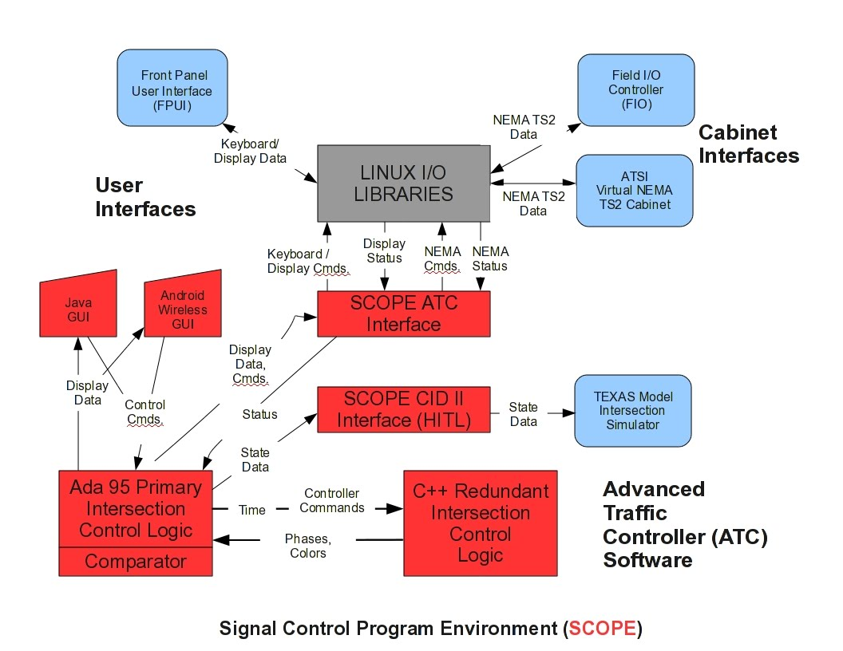
System Architecture

Slide 17
Objectives of SCOPE
Create open source traffic control software, developed using only open source toolsets.
Create dual redundant safety-critical traffic control software.
Expose software fault information, which is currently proprietary.
Provide a platform for traffic control research.
Increase traffic control software efficiency and stability.
Spur interest in traffic signal control.
Allow third-parties to alter traffic control logic to best meet a given city’s needs.
Advance the DOT’s initiative of the Connected Vehicle.

Slide 18
TEXAS Model
SCOPE makes use of the Traffic EXperimental Analytical Simulation (TEXAS) Model for Intersection Traffic.
Microscopic single-intersection vehicular traffic simulation model of an at-grade intersection or diamond interchange.
Model allows simulation of three to six leg intersections, with a maximum of six inbound and six outbound lanes per leg.
Interface classes written to allow the primary software to communicate with the TEXAS Model FORTRAN code.
Allowed SCOPE to be tested in a single intersection environment.
Hardware-in-the-Loop (HITL) using SCOPE’s Controller Interface Device software coupled to TEXAS Model.

Slide 19
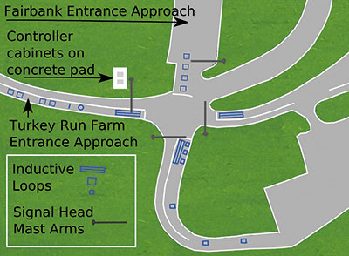
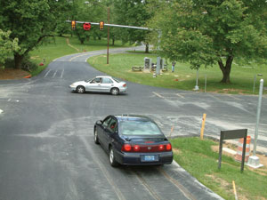
Testing
Testing to occur at Turner-Fairbank Highway Research Center.
The TFHRC contains an intelligent test intersection used for intersection collision avoidance systems .
Performing formal qualification at this intersection at TFHRC will allow ATI to use live actuators and traffic.

Slide 20
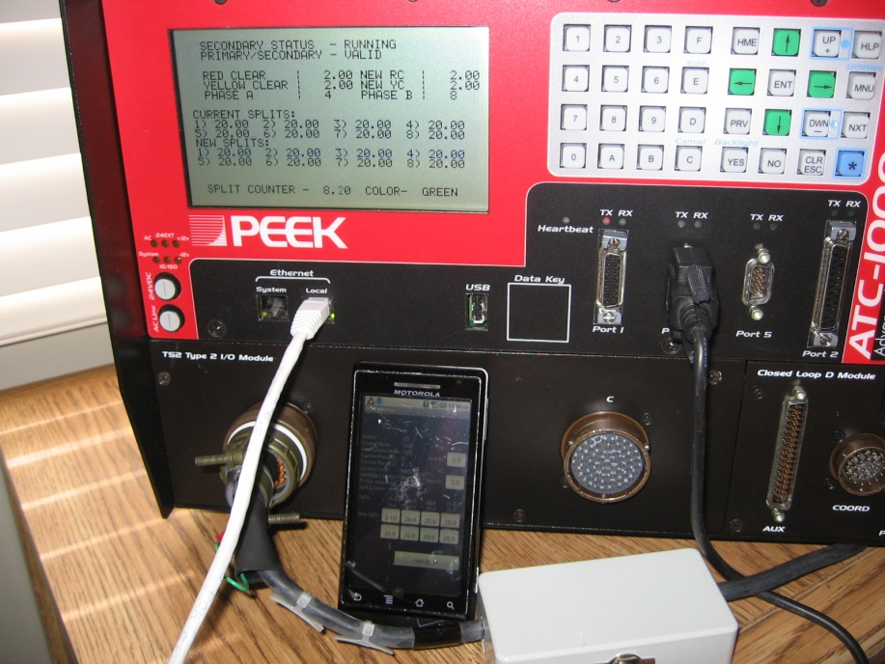
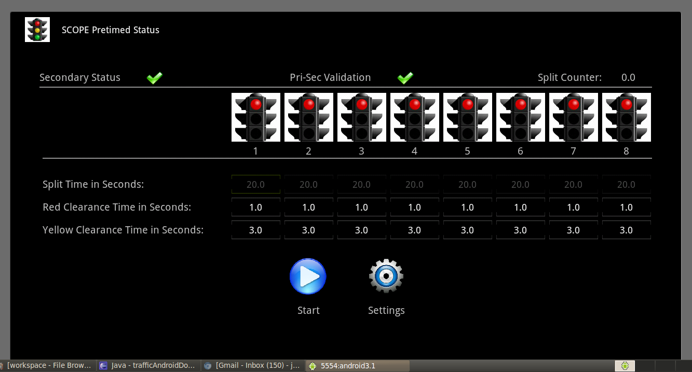
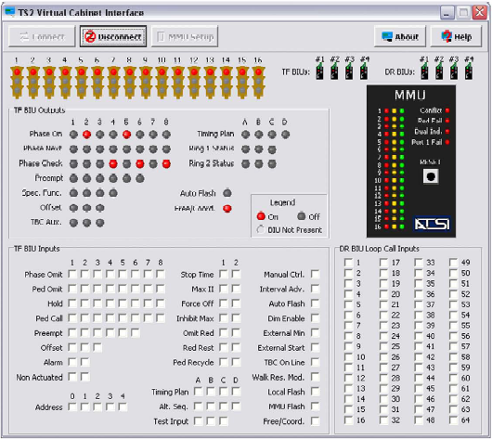
Demo

